Slide 1
Soft-Linking and Model Reduction Techniques for
Large-Scale Energy System Modelling
Mathias Berg Rosendal
Supervisors & Collaborators: Marie Münster, Rasmus Bramstoft, David Pisinger (DTU)
Jean-Marc Janin, Thomas Heggarty (RTE)
Robin Girard (PERSEE)
Notes:
S1
- Thank you all for coming to hear about my thesis with the.. very catchy title "Soft-linking and ..."
- Hopefully by the end of this thesis the majority in this room will know what that means.

Slide 2
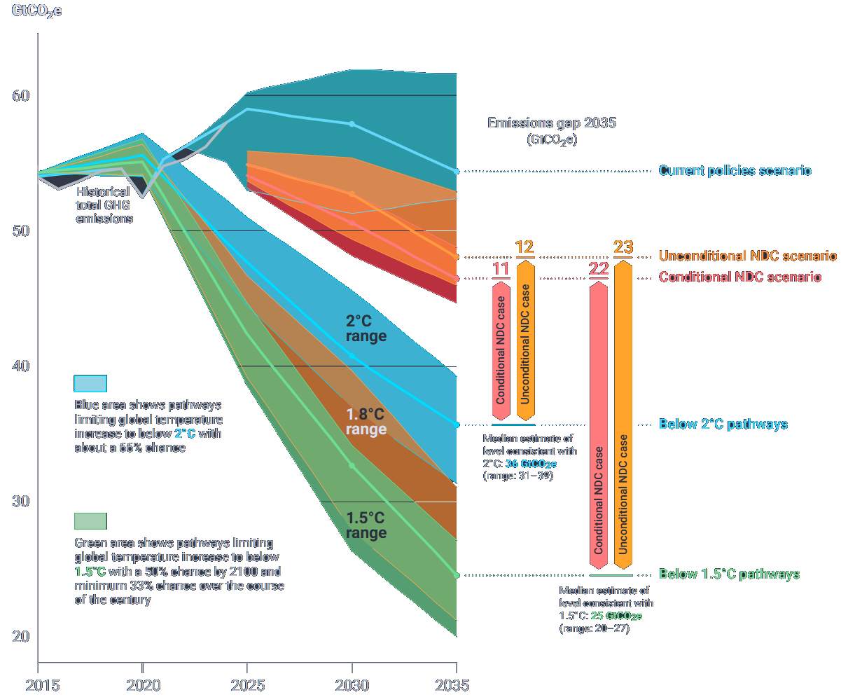


The Progress of Mitigating Climate Change
Figure from: United Nations Environment Programme. Emissions Gap Report 2025: Off Target - Continued Collective Inaction Puts Global Temperature Goal at Risk. 2025. https://doi.org/10.59117/20.500.11822/48854.
Notes:
S2
- The grand challenge motivating today's topic relates to climate change, and how we can keep temperatures within a safe operating space.
- The emissions gap report projects emissions based on current and stated policies,
- and illustrates that there's still a large gap to being on track to reach the emission reduction targets that would lead to a 2 or 1.5 degree warmer world

Slide 3
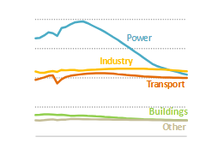
Energy Sector Emission Trajectories with NDCs
Figure from: IEA. World Energy Outlook 2025. 2025.
Notes:
S3
- The emissions from the energy consumption is significant, and is here divided into sectors in the stated policies scenario.
- It hints that some sectors might be easier to decarbonise than others,
1. ...and that it is important to also consider other sectors.

Slide 4
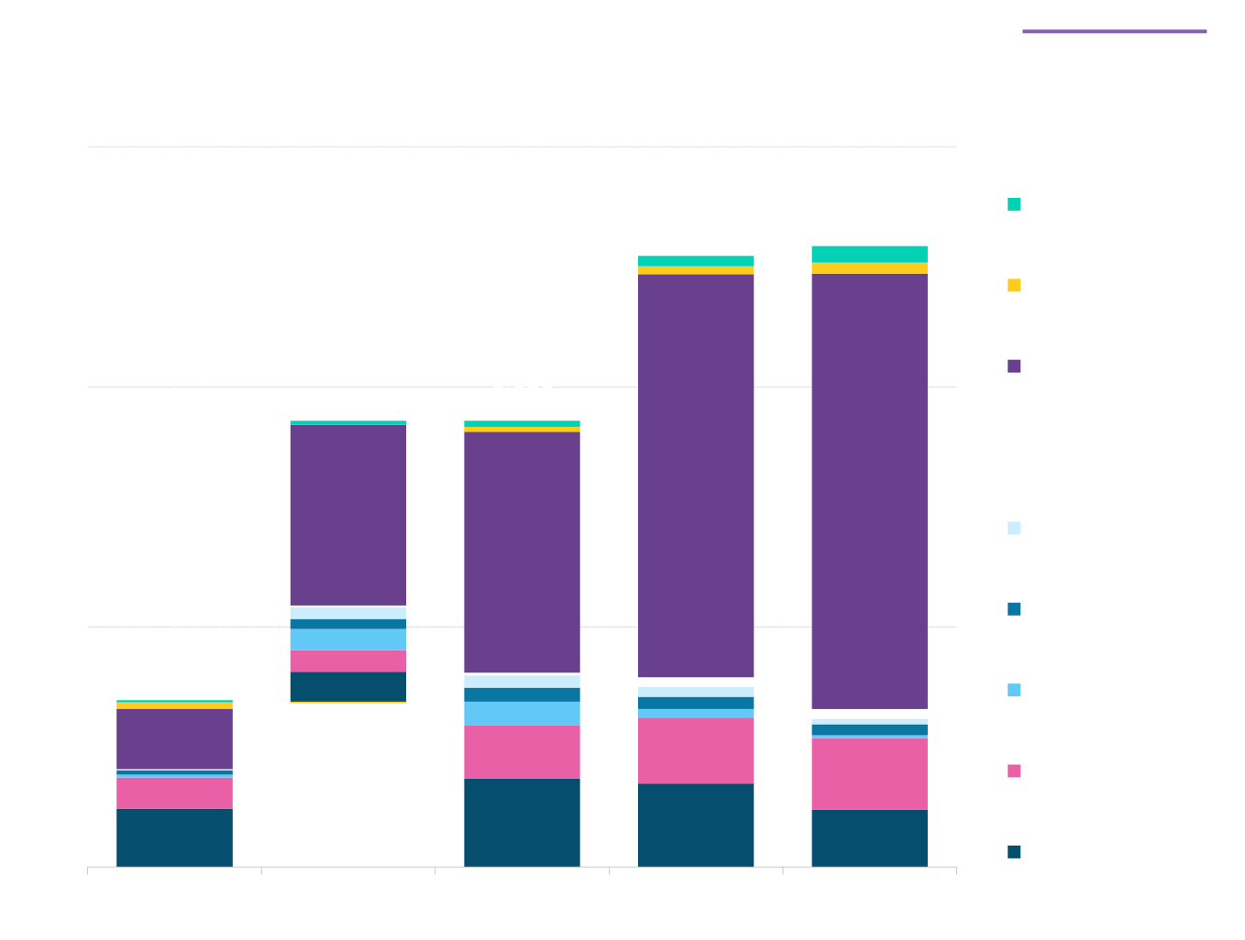
What level of investments are required?
Figure from: Bloomberg. Energy Transition Investment Trends 2025. 2025.
Notes:
S4
1. The higher decarbonisation rate of the power sector is related to investments in renewable energy and power grids, which hit a 2 B dollar record in 2024 according to Bloomberg
2. They estimate that this level should more than double immediately to get on track with climate targets,
3. and triple by 2036 and remain at that level until 2050.

Slide 5

How are those analyses used?
Public debate and policy-makers
Investment decisions and
long-term planning
Companies



1
2
Institutions
N
Energy System Blueprints
Agencies
Notes:
S5
- These are useful numbers, provided by mathematical models
1. the energy system blueprints that models provide can help conceptualise the challenges and solutions of the energy transition
2. They can also support infrastructure companies and producers in making decisions and plans that are robust to a large range of possible futures.

Slide 6

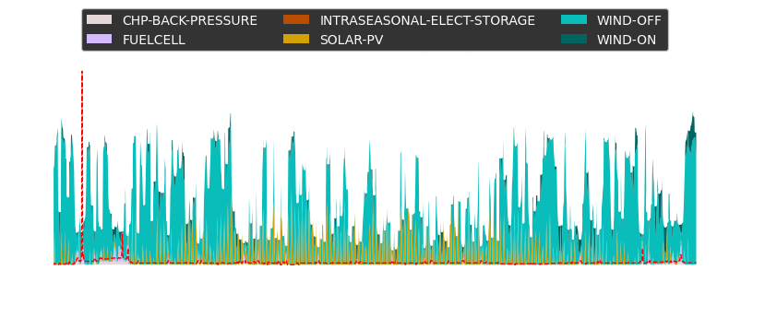

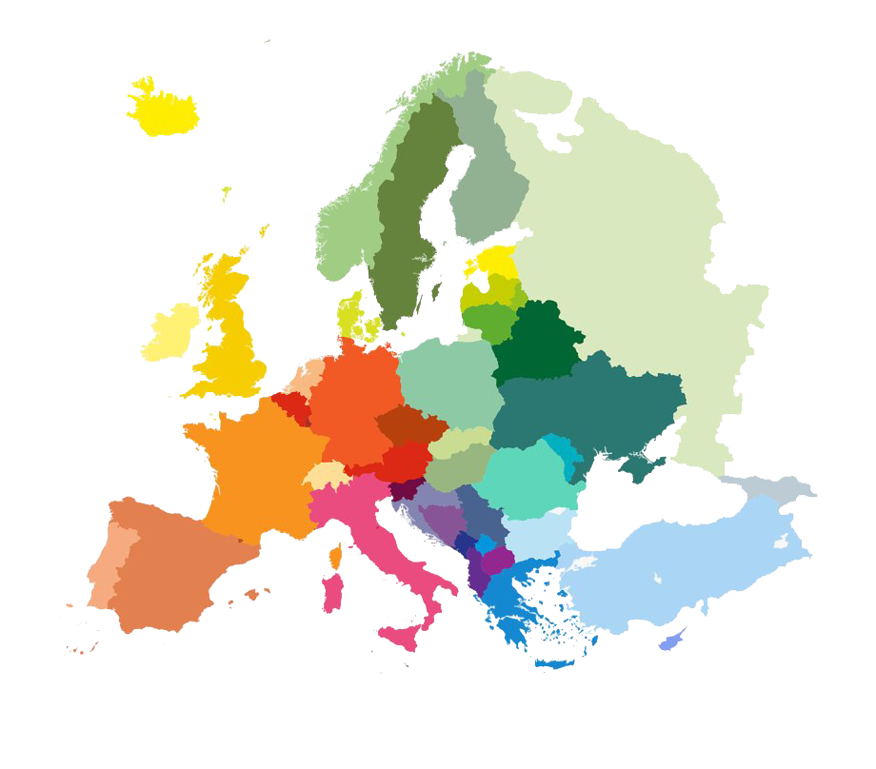
Classic Sources of Complexity for Large-Scale Energy System Modelling
Spatio-temporal Resolution
Sector Coupling Dynamics
Economy of scale or
unit commitment
Hydrogen Storage
H2
Electrolyser
Power
Heat Pump
Heat
Heat Storage
Right figure: Alekseeva et al.¹⁴
Notes:
S6
- However, it is complex task to make an accurate mathematical depiction of a large-scale energy system and solve it.
1. This is because such models need to include a lot of temporal data to account for the seasonal and hourly fluctuations of renewable energy, and spatial data to account for the opportunity and costs of evening out the fluctuations of renewable energy through interregional trade.
2. Furthermore, as mentioned previously, if we only look at the power sector we completely neglect the opportunities and costs of inter-sectoral dynamics, such as storing heat and hydrogen instead of electricity, through heat pumps and electrolysers.
3. Finally, the large-scale energy system models that is the topic of today typically follows a linear programming methodology, which simplifies some technical constraints related to economy of scale and the fact that there are costs and constraints to power plants turning repeatedly on and off.

Slide 7
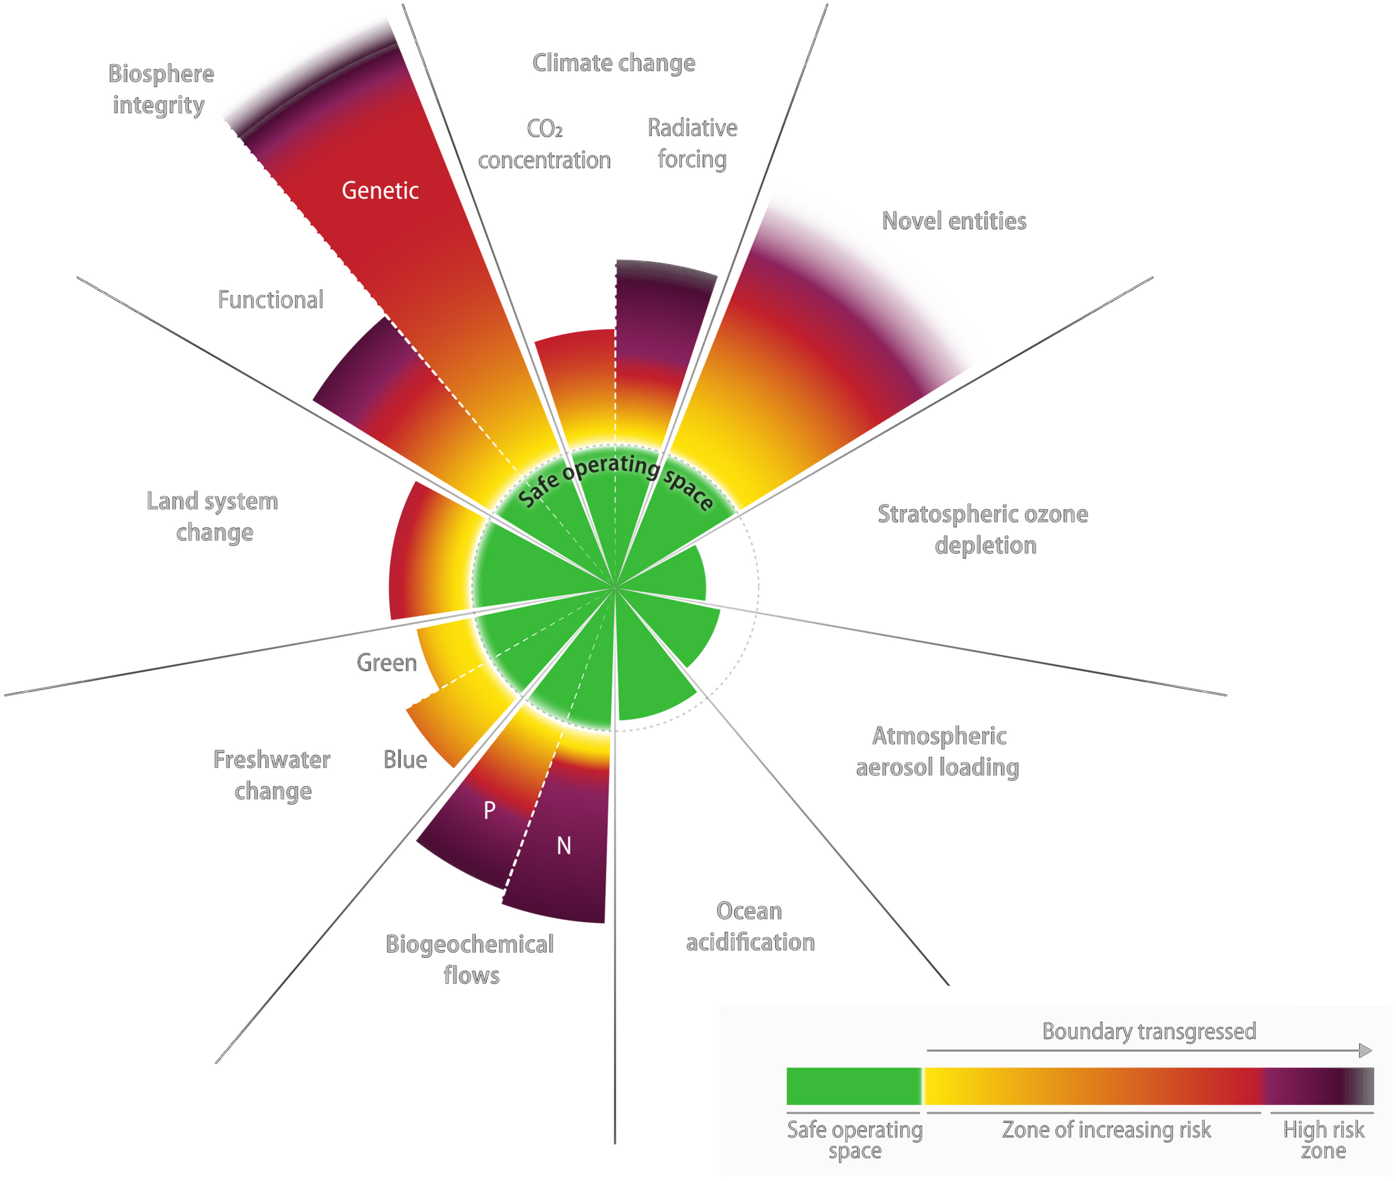
Future Sources of Complexity for Large-Scale Energy System Modelling
Planetary Boundaries
Behavioural Aspects
Left figure: Richardson et al.¹³
Notes:
S7
4. Those were some of the 'traditional' complexities, but in the future we might not be able to avoid that the list of complexities grows beyond greenhouse gas emissions, which is only one of our ecological crises as shown by the work on planetary boundaries.
5. And behavioural aspects is often quite simplified, which e.g. could be relevant wrt. the roll-out of a certain technology to households.

Slide 8
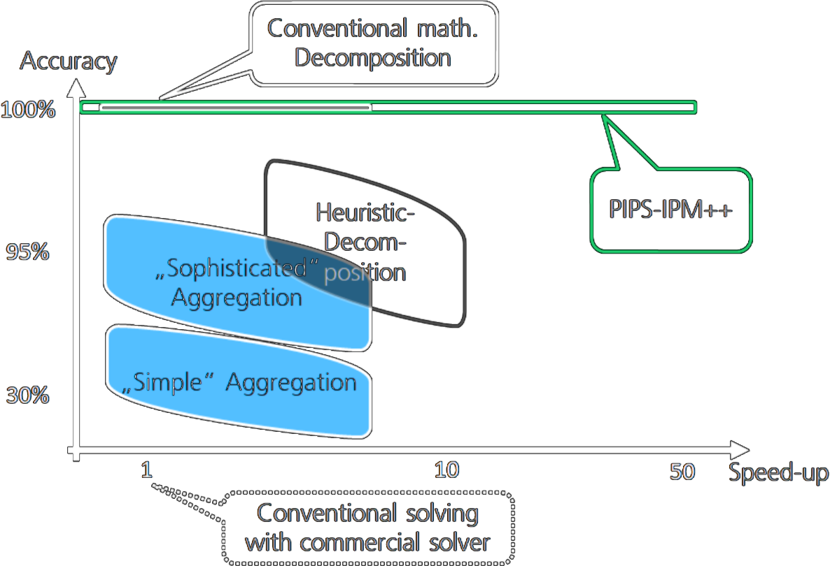
Methods for Complexity Reduction
Decompose mathematical formulation into master and subproblems¹⁷
Precision
Heuristic decomposition, e.g. solving one week at a time¹
Temporal³-, spatial¹⁰- and technological¹¹ aggregation
Speed-up
Figure from Scholz et al.¹
Notes:
S8
- Hence, modellers apply various methods to reduce the computational complexity of a model while keeping it precise in its description of the problem at hand.
1. Including temporal-, spatial- and technological aggregation techniques,
2. Heuristic methods that follow a rule-based approach to solving complex problems, e.g. the rolling horizon idea of breaking an optimisation of a full year into weekly problems.
3. and decomposition of the mathematical formulation of the problem into master- and subproblems

Slide 9
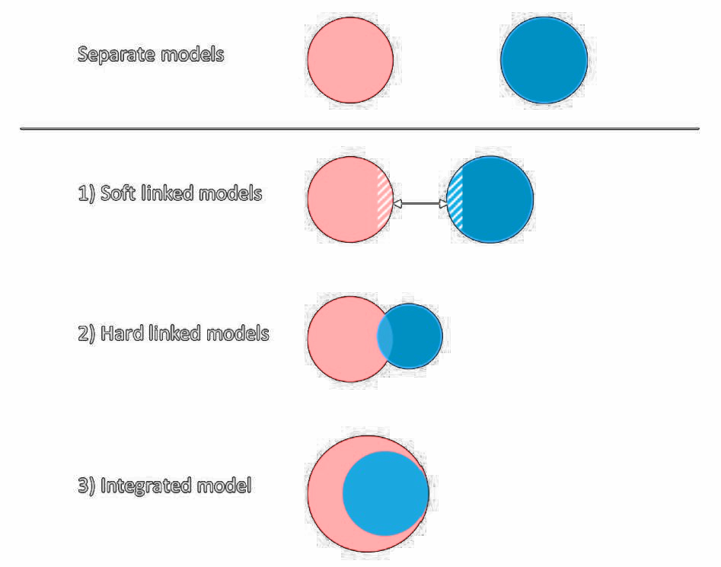
Soft-Linking as a Method for Complexity Reduction
Increases model size…
Figure from: Helgesen, Per Ivar, and Asgeir Tomasgard. “From Linking to Integration of Energy System Models and Computational General Equilibrium Models – Effects on Equilibria and Convergence.” Energy 159, 2018
Notes:
S9
- I will argue that soft-linking can be seen as another complexity reduction technique
- Soft-linking is the act of combining standalone models that are solved separately through one or several iterations of data exchange,
1. in contrast to hard-linked or integrated models, where the solving process of the coupled models is simultaneous, which increases complexity

Slide 10
Soft-Linking as a Method for Complexity Reduction
Precision
Optimality not guaranteed
Otherwise intractable problems can be analysed
Soft-Linking?
Speed-up
∞
Figure adapted from Scholz et al.¹
Notes:
S10
- Some forms of soft-linking could be included in heuristic decomposition techniques, but I would argue that soft-linking of different frameworks could be seen as a less precise complexity reduction technique, with an infinite speed-up potential
- This is due to the fact that optimality is not guaranteed, maybe to even to a lesser extent than heuristic decomposition techniques, but it can shed light on otherwise intractable problems.

Slide 11

Accuracy vs. Precision
Inaccurate and precise
Accurate and imprecise
Thompson et al.¹⁸: Chase of optimality can lead to worse decision support than the combined worldview of several models
Notes:
S11
- And when we talk about 'precision' we should also be mindful of the worldview that are assumed by different models:
1. The economist, Erica Thompson, criticises her colleagues for pursuing 'optimality' - or 'precision' -
2. and argues that a modeller should expose themselves to several models, or at least multiple scenarios or solutions beyond the optimality gap, in order to deliver more 'accurate' decision support

Slide 12
Overarching Research Objective
To analyse and compare soft-linking and model reduction techniques for large-scale, sector-coupled ESM
Weather
Sectors
Space
Notes:
S12
- But of course, increasing precision is still valuable, and this is why the overarching objective of this PhD has been to propose and...
- The work I did touches upon three important sources of complexity related to,
1. weather conditions,
2. sectoral scope and
3. spatial resolution

Slide 13
Weather research gap
Weather
Uni-directional studies to evaluate the adequacy of an optimised
fleet of capacities are common¹⁵
A bidirectional approach is necessary to explore configurations that are cost-optimal and adequate²⁰
Pan-European bi-directional studies are more rare⁴, ⁵
No pan-European study have compared bi-directional strategies and included the adequacy of another sector in such a study
Research gap in a study systematically evaluating
different bi-directional soft-linking methods and their potential impact on results
Notes:
S13
- As mentioned, these resource adequacy assessments require a lot of weather scenarios to test the to account for extreme events on the long-term.
- Uni-directional studies to evaluate the adequacy of an optimised fleet of capacities is common
- A bidirectional approach is necessary to explore configurations that are cost-optimal and adequate
- Pan-European bi-directional studies are more rare
- No pan-European study have compared bidirectional strategies and included the adequacy of another sector in such a study
- Research gap in a study systematically evaluating different linking methods and their potential impact on results

Slide 14
Sectors research gap
Sectors
State-of-the-art ESMs often include other sectors explicitly⁶,⁷
Some examples of model couplings across sectorally different models⁸, but no proposed sector agnostic approach
Demand response has been used to model flexibility from other sectors, but tend to use data from the existing energy system⁹
A method to aggregate results from a prospective sector coupled model to a demand response model could be a potential soft-linking strategy across sectorally different models
Research gap in a systematic analysis of a simple soft-linking technique between sectorally different
simulation models
Notes:
S14
- State-of-the-art ESMs often include other sectors explicitly
- Some examples of model couplings across sectorally different models, but no proposed sector agnostic approach
- Demand response has been used to model flexibility from other sectors, but tend to use data from the existing energy system
- A method to aggregate results from a prospective sector coupled model to a demand response model could be a potential soft-linking strategy across sectorally different models
- Research gap in a systematic analysis of a simple soft-linking technique between ESMs and power simulation models

Slide 15
Space research gap
Space
Soft-linking techniques proposed for decomposing spatial problems¹²
– model reduction techniques can still be a ’competing’ approach in many cases
Studies looking into spatial aggregation techniques mostly focus on the power system¹⁰
Examples exist where other sectors are optimised at various resolutions, but only for a constant configuration of the spatial layers²¹
No systematic analysis of how to represent carriers in a sector coupled ESM in addition to altering spatial resolution
Research gap in a systematic comparison of the spatial representation of energy carriers in a sector-coupled ESM
Notes:
S15
- Soft-linking techniques have been proposed
- but this presentation will illustrate they can be complicated
- meaning model reduction techniques will still be interesting as a ’competing’ approach in many cases
- studies mostly focus on the power system
- Examples exist where other sectors are optimised, but only for a fixed configuration of the energy carriers.
- No systematic analysis of how to represent carriers in a sector coupled ESM in addition to altering spatial resolution
- Research gap in a systematic comparison of heat and hydrogen representation in a sector-coupled ESM

Slide 16
Research Questions
RQI
Weather
How can investment- and operational models be soft-linked for prospective capacity adequacy analyses?
RQII
Sectors
How can electricity demands from heat and hydrogen sectors be represented in power system models?
RQIII
Space
How can energy carriers be aggregated and represented geographically in energy system models?
Notes:
S16
- These research gaps lead to three research questions that all touch on a source of complexity in energy system modelling
- How can...
- How can...
- How can...

Slide 17
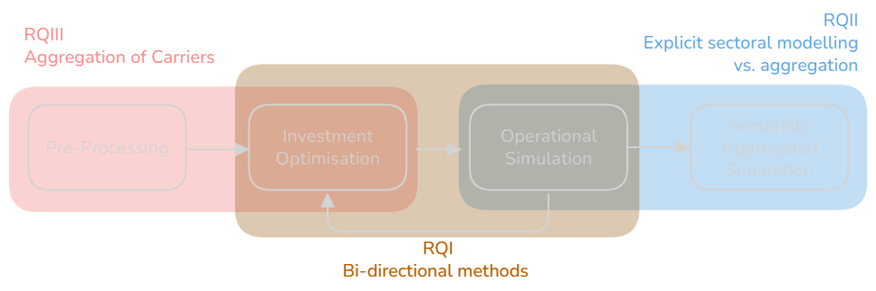
Research Framework
Notes:
S17
- These questions are covering the following part of the modelling toolchain
- Question III on carrier representation is related to the pre-processing step and investment optimisation
- Question I concerns the bi-directional evaluation of investment optimisation using results from operational simulations
- and question II addresses a potential soft-linking application between sectorally different models

Slide 18
Overall Methodologies
Notes:
S18
- So, we move on to the methodologies I applied.

Slide 19


Methodologies
Representing energy system optimisation models
(PyPSA, OSeMOSYS, LUT, Calliope ...)
Investment & operation optimisation of supply, transport, storage and conversion of energy
Time slices constructed with either representative periods or using clustering
Full foresight applied within model year, myopic foresight across model years
Representing scenario-based,
energy system simulation models
(EnergiPLAN, STREAM, Dispa-SET, ...)
Operational simulation of supply, transport, storage and conversion of energy
Stochastic scenarios at hourly resolution, with the possibility of random mixing
Residual load heuristic or water value approach to solve weekly simulations
Notes:
S19
1. Energy system optimisation models and power system simulation models can help answer these questions, so I've used a representative from each discipline: BALMOREL and ANTARES
2. Models assume perfect market conditions in the minimisation of when optimising or simulating supply, transport, storage and conversion of energy
3. BALMOREL requires temporal aggregation, whereas hourly resolution for many scenarios, e.g. weather years, are used for ANTARES
4. Full foresight in BALMOREL, heuristic applied for weekly problems in ANTARES
- BALMOREL could have been used as the simulation model for many scenarios as well, but since one of the challenges in model coupling is the fact that you often need to couple frameworks with different formats, model formulations and data structures, it would be 'cheating' to just do that
- Hence, I applied ANTARES simulator for that part to include this harmonisation challenge in the project.

Slide 20


Methodologies
RQI
Weather
RQII
Sectors
RQIII
Space
opt.
sim.
BALMOREL  ANTARES
BALMOREL  BALMOREL
BALMOREL  ANTARES
Comparing bi-directional strategies to alter the investment optimisation problem in BALMOREL
BALMOREL  BALMOREL
Comparing spatial representations and resolutions of heat and hydrogen
opt.
sim.
opt.
sim.
opt.
sim.
Comparing explicit- and demand response-modelling of
heat and hydrogen
Notes:
S20
1. Different combinations of optimisations and simulations were used,
2. and i compared methods for each research question
- In the first research question related to the complexity of weather conditions, three bi-directional approaches are tested to update the investment optimisation problem in BALMOREL, based on the adequacy resulting from multi-weather year simulations in ANTARES
- In research question II, BALMOREL simulations with explicit modelling of other sectors are carried out for various scenarios, and compared to the proposed demand response representation in the corresponding ANTARES simulations
- In research question III, various ways to organise heat and hydrogen in the spatial layers of the ESM are compared for various spatial resolutions.

Slide 21
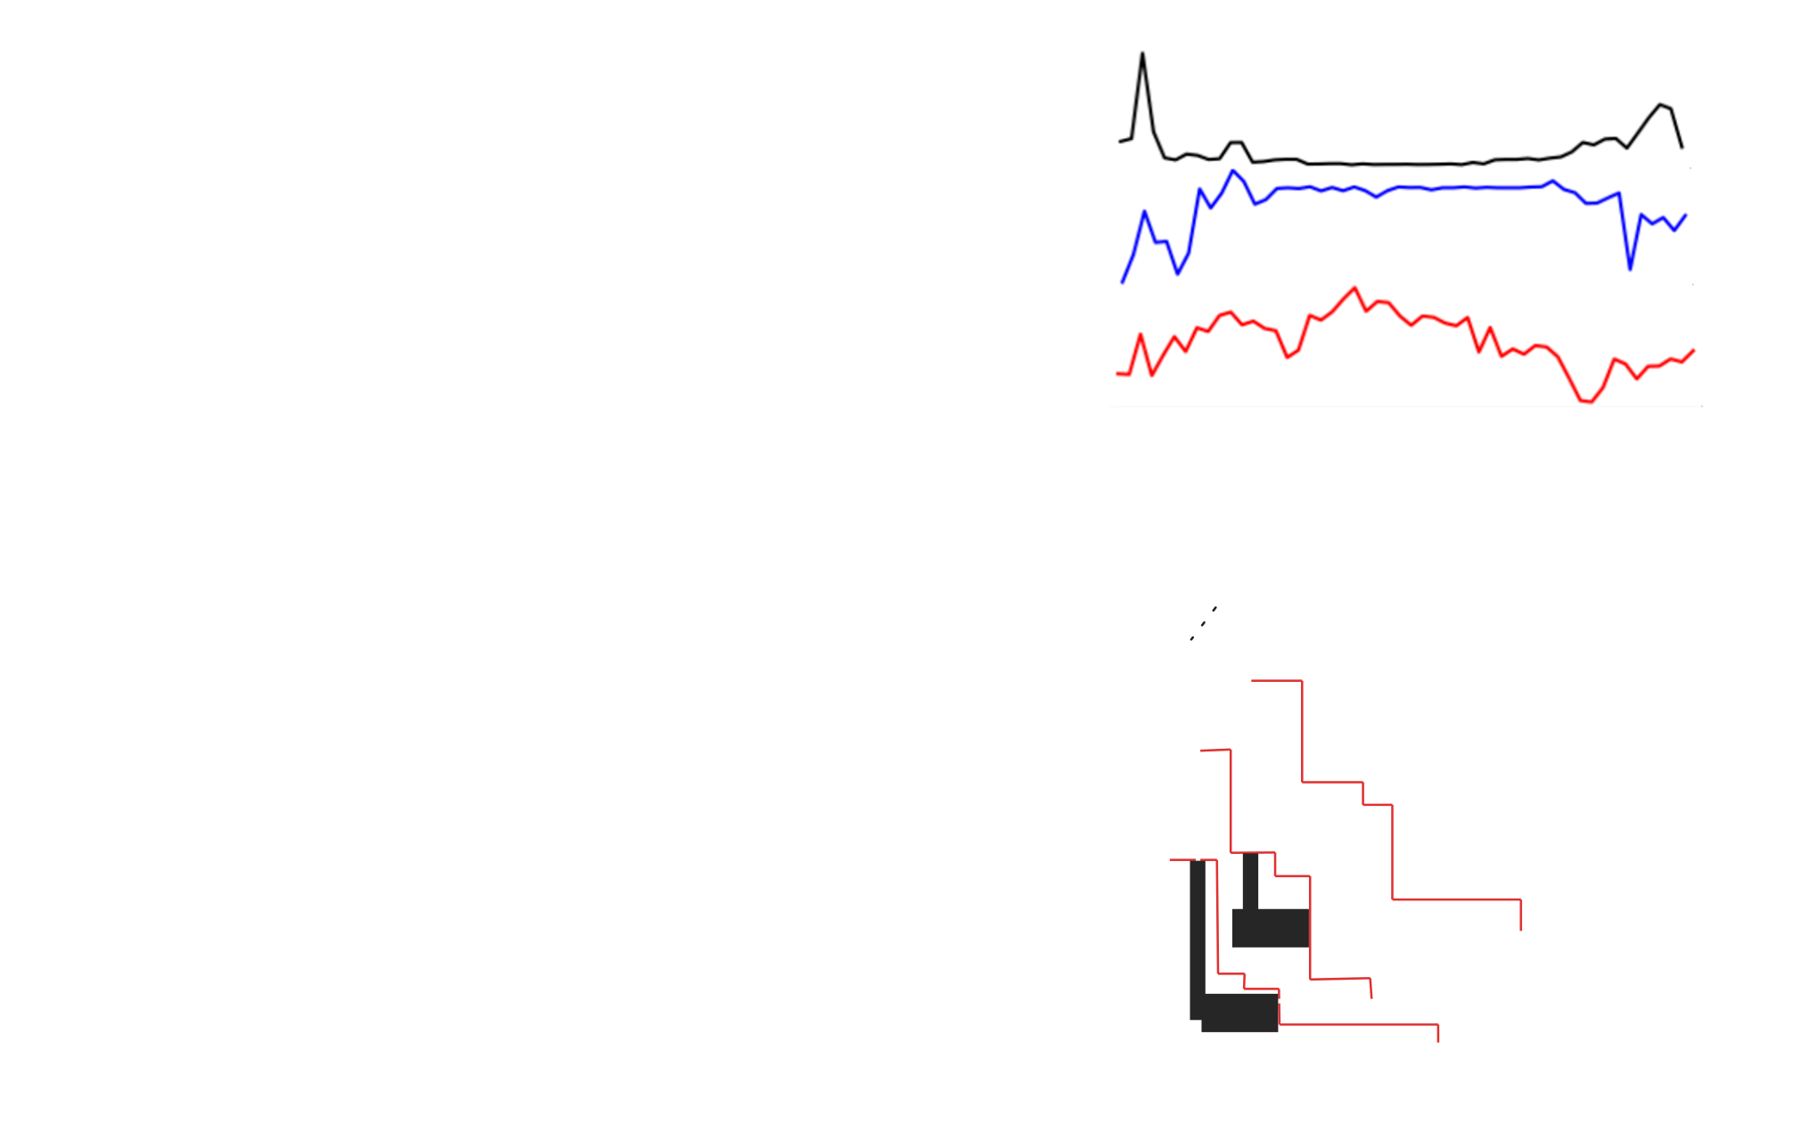



Case Studies
RQI
Weather
RQII
Sectors
RQIII
Space
Electricity and hydrogen
Europe
Carbon-tax driven
2020, 2030, 2040, 2050
Scenarios of increasing sectoral complexity
DE/FR/ES and Europe
Carbon-tax driven
2050
Electricity, hydrogen,
heat and RE fuels
Denmark
Net-zero limit
2050
Notes:
S21
- A variety of case studies were used, with various sectoral scopes
- The geographic scopes are mainly European, with the exception of RQIII due to data availability, for example on high-resolution district heating demands
- A net-zero constraint by 2050 is used for RQIII because this stricter approach enhanced spatial effects, whereas the carbon tax allows us to probe how the methods tested in RQI affect the energy trilemma trade-off
- Finally, 2050 has been the primary focus since these methods are most relevant for prospective studies, but several model years were included in the analysis for RQI

Slide 22
Research Questions
Notes:
S22
- I will now go through each of the research questions, explaining the method variants and main findings

Slide 23
RQI: How can investment- and operational models be soft-linked for prospective capacity adequacy analyses?
Notes:
S23
- Starting with research question I: "How can..."

Slide 24
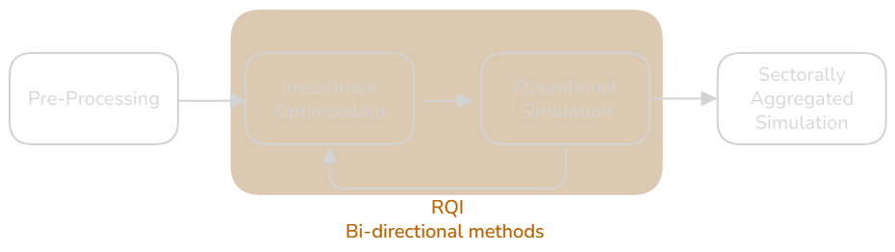
Motivation and Expectations
Support modellers that seek to couple investment optimisation runs to operational simulations to find (near) optimal and adequate capacities
Hypothesis: Various approaches could lead to various results, motivating a systematic comparison
Notes:
S24
- As mentioned, this research question aims to contribute with methodologies for modellers that want to couple investment optimisation runs to operational simulations, a task that is necessary for TSO's in long-term planning of the system.
- Our hypothesis was that the various approaches in the literature on such bidirectional couplings will lead to different results

Slide 25


Constraint-based Incentive Strategy
Capacity Credit
= a measure of the technology- or interconnectors’ ability to contribute to load
Weighted by capacity credit
For all model years, regions, carriers, technologies and interconnectors
At iteration i + 1…
¹Heggarty, Thomas. “Techno-Economic Optimisation of the Mix of Power System Flexibility Solutions.”, PhD Thesis, Université Paris, 2021.
²Alimou, Yacine, Nadia Maïzi, Jean-Yves Bourmaud, and Marion Li. “Assessing the Security of Electricity Supply through Multi-Scale Modeling: The TIMES-ANTARES Linking Approach.” Applied Energy 279 (December 2020): 115717. https://doi.org/10.1016/j.apenergy.2020.115717.
Notes:
S25
- The first variant is based on capacity credits, inspired by the work of my the work of Heggarty, Alimou and IEA.
- There are different ways to define this metric, but in this thesis, i define the capacity credit as a measure of the technology- or interconnector's ability to contribute to load while accounting for the load time series
- It is based on ANTARES simulations throughout all weather years
- This measure is used for a new equation in BALMOREL where the capacity variable of all technologies and interconnectors, weighted by capacity credit, must be higher than the sum of peak demand and a function that will change based on the loss of load expectancy in a region
- Hence, for a specific region, capacity credits are re-calculated for every iteration, and the right-hand side will increase or decrease, depending if loss of load is either below or above three hours.

Slide 26
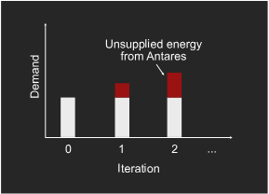
Parameter-based Incentive Strategy
Fictive Demand
A function of unsupplied energy through weather years
For all model years, regions and carriers
¹Inspired by Fortes, P., Pereira, R., Pereira, A., Seixas, J., . Integrated technologicaleconomic modeling platform for energy and climate policy analysis 73, 716–730. URL: https://www.sciencedirect.com/science/article/pii/S0360544214007749, doi:10.1016/j.energy.2014.06.075.
Notes:
S26
- The second approach is inspired from couplings between macroeconomic models and energy system models, where the annual demand is often decided by the macroeconomic model.
- I call this parameter-based approach the 'fictive demand' method, because it essentially adds demand to the region, for the specific carrier that has a loss of load expectancy higher than 3 hours.
- If the loss of load expectancy drops below 3 hours, this part will decrease again to avoid overinvestments
(could potentially include figure of the function if time allows)

Slide 27
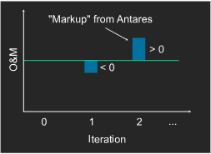
Objective Function-based Incentive Strategy
Profit Signal
=
For all model years, regions, carriers and technologies
¹Gong, Chen Chris, Falko Ueckerdt, Robert Pietzcker, Adrian Odenweller, Wolf-Peter Schill, Martin Kittel, and Gunnar Luderer. “Bidirectional Coupling of a Long-Term Integrated Assessment Model REMIND v3.0.0 with an Hourly Power Sector Model DIETER v1.0.2.” arXiv, October 6, 2022. https://doi.org/10.48550/arXiv.2209.02340.
Notes:
S27
- Finally, the third variant is what i call the profit signal approach,
1. where a new term is introduced in the BALMOREL objective function comprising the generation variable and the difference in profit of that technology between the two models
2. Since BALMOREL optimise capacities, profits are zero, meaning this reduces to the profit per MWh of ANTARES simulations
3. this new term essentially decreases the O&M costs of the technology throughout iterations,
4. but differently so for each technology, which the study that I'm inspired of found effective to harmonise capacities in a coupling of an integrated assessment model to a power system model, and argued this is a more 'endogenous' soft-linking approach compared to a constraint-based approach, as it leaves the solution space unaltered

Slide 28
RQI: Main Findings
Notes:
S28
- The main findings of these tests ...

Slide 29
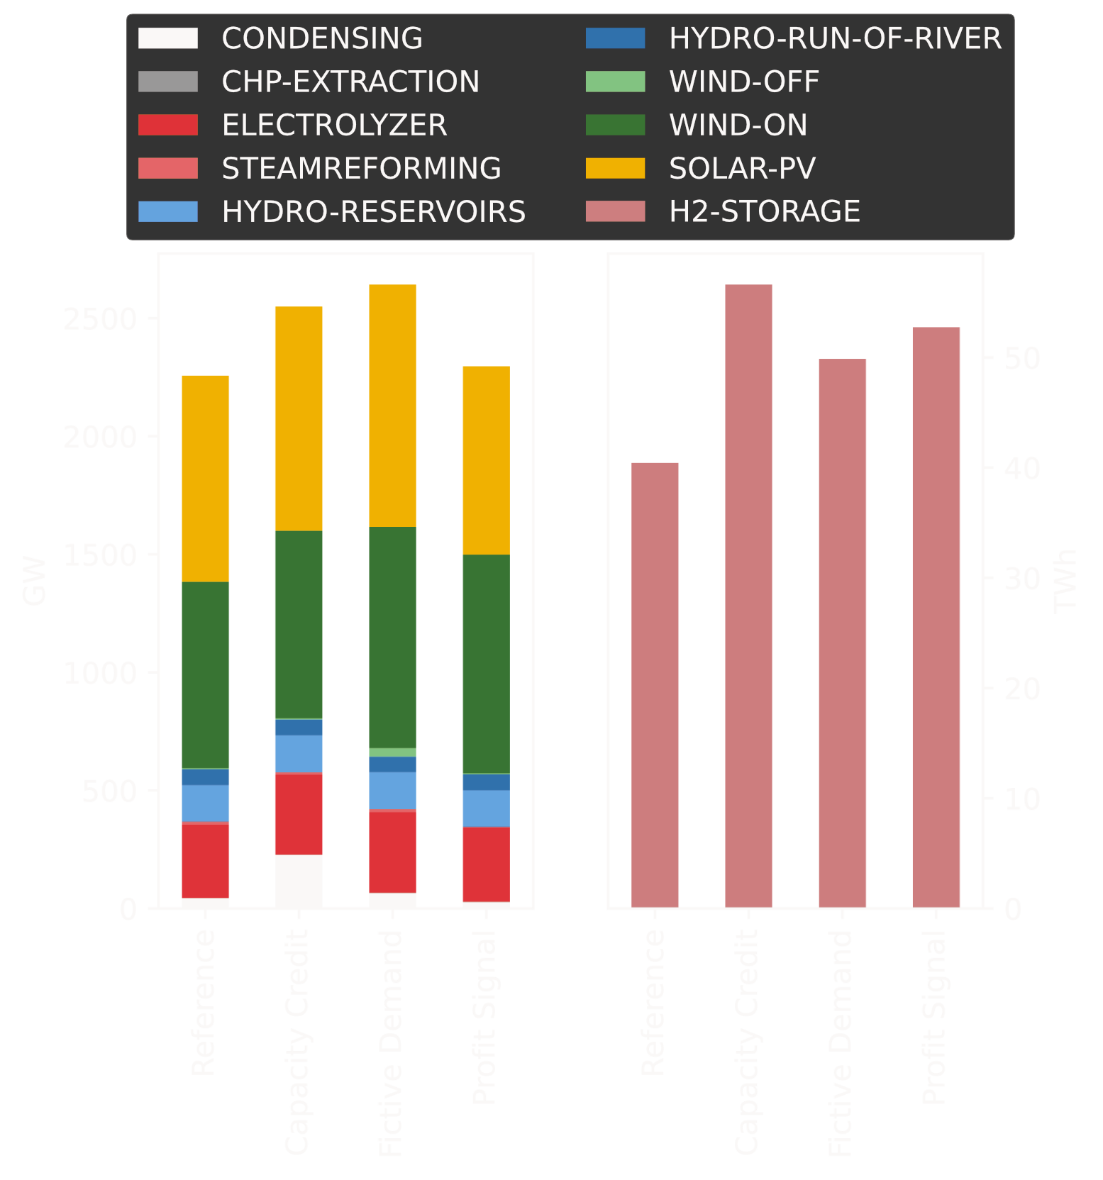
Capacities in the First Iteration (Reference) and in Adequate Solutions
13-17% more generation capacity compared to first iteration
Capacity Credit:
More condensing (natural gas CCS) capacity. Lower costs and higher emissions
Fictive Demand:
Lower emissions, due to more VRE.
Slightly costlier due to larger capacities
Profit Signal:
Oscillated between inadequate states.
Method inspired by coupling of investment models w/o adequacy focus
Notes:
S29
- Is that we generally see 13-17% more generation capacity at a comparable, 'adequate iteration' compared to the first iteration, where BALMOREL did not receive any incentive
- However, the configuration of the energy system is not the same at this adequate iteration for the various incentive strategies
- The capacity credit approach favours more gas turbine capacity. This can be explained by the definition of the capacity credit i used, which is higher when load is high, where condensing capacities are often in use and renewables will only randomly have potential for generation.
- This definition didn't succeed in lowering the loss of load expectancy for hydrogen, despite it increasing hydrogen storage capacity.
- However, if i assume a value of lost load for hydrogen that is similar to electricity, the system is accurate. On the other hand, gas turbine electricity is then used to produce electrolytic hydrogen.
- The fictive demand approach lead to more renewables and transmission capacity, and a larger total generation capacity.
- I explain this by the fact that adding more demand just generally increases capacities as the load profiles are stretched. Of course, this effect is conditional to the potentials of each technology not being fully realised, which means it could be interesting to see what starts to happen when potentials are realised, e.g. by including the heating sector in a follow-up to this study.
- The profit signal approach was not really promising in my setup, as capacities fluctuated between two inadequate states,
- This approach was inspired by a study coupling two investment optimisation models, and didn't have a multi-weather year adequacy focus
- I.e.: The models had more similar cost representations than in my case, and the idea that it could be transferred to an adequacy proved wrong.

Slide 30
Limitations
Only electricity and hydrogen – inclusion of heating sector and a demand response EV increases demand, but also introduces new flexibilities
Including details on unit commitment will increase the additional capacity, although one study claims that temporal resolution is the largest share (cite)
Three methods tested, but there could be many ways to design a bidirectional strategy, we didn’t necessarily include the best
E.g.: iteratively adding extreme periods based on optimisation results¹⁹
Notes:
S30
- There are, however, some limitations to the work that I've done ...
- Heat and V2G
- Unit commitment
- Only three methods
- Iteratively adding extreme periods could have been interesting to include in the comparison as it seemed promising in terms costs and emissions

Slide 31
Research Question Answers
Weather
How can investment- and operational models be soft-linked for prospective capacity adequacy analyses?
Capacity credits and fictive demand can be effective coupling strategies
  Capacity credit: Low cost solution with higher emissions
  Fictive demand: Low emission solution with higher costs
Future research could advance the capacity credit method to account for sector-coupling dynamics
Notes:
S31
- Overall, to answer the research question "How can..."
- I conclude that capacity credit method and the fictive demand approach can be effective coupling strategies to find adequate capacities, though with solutions in various corners of the energy trilemma
- I think future research could work on the capacity credit method to account for sector coupling dynamics, for example by including some terms in the constraint for conversion technologies

Slide 32
RQII: How can electricity demands from heat and hydrogen sectors be represented in power system models?
Notes:
S32
- Moving on to the second research question, how can...

Slide 33
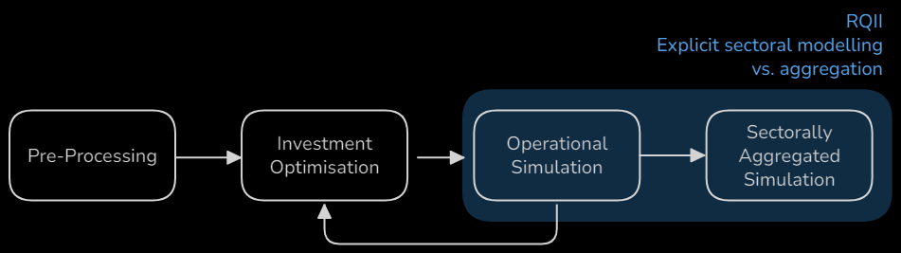
Motivation and Expectations
Support modellers that need to couple sectorally different models
Hypothesis: Demand response have been used to represent flexibilities
from components in other sectors, and could be an endogenous way to
represent a whole sector.
Expecting this approach to be less accurate for increasing sectoral- and
geographical complexity
Notes:
S33
- The motivation for this research question is to develop methods for coupling sectorally different models, e.g. for a TSO that has mainly worked with power system simulations and want to account for sector coupling while keep using the models that their regulators have learned to trust.
- Our hypothesis here was that a demand response model could be used, as it has been historically used in energy system modelling to represent flexibilities from components in other sectors.
- Maybe it can also be used to represent a whole sector, using model results, to establish a coherent coupling framework for prospective studies.

Slide 34
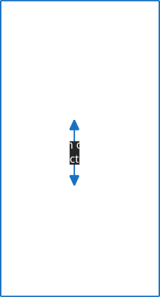

Framework
Convert PtH2 and PtH results to demand curves
=
Curtailable and shiftable demand response
Notes:
S34
1. The approach is to convert BALMOREL simulation results of heat and hydrogen power demands to a model of curtailable and shiftable demand response in ANTARES
2. Hence, we are comparing explicit- and simplified modelling of other sectors

Slide 35

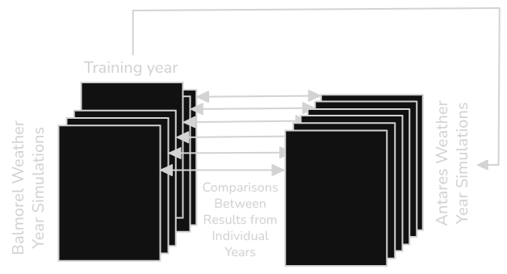
Cross-Weather Year Comparisons for Small System Case Study
Results 1…M
Results 1...N
Notes:
S35
- One motivation for this method is that you could couple a sector-coupled ESM to a power system simulation tool that simulates several weather years
1. In that case, it would be much less useful if you'd have to simulate the ESM for all weather years, instead of just for one year and then extrapolate.
- We tested this for a small case study by simulating BALMOREL for a lot of weather years, and then extrapolate the demand response representation from each of those years, to all weather years in ANTARES input
- This means that we can compare a lot of simulations, and figure out if this method works with just one weather year simulated in the ESM

Slide 36
RQII: Main Findings
Notes:
S36
- So, to the main findings of this research question...

Slide 37
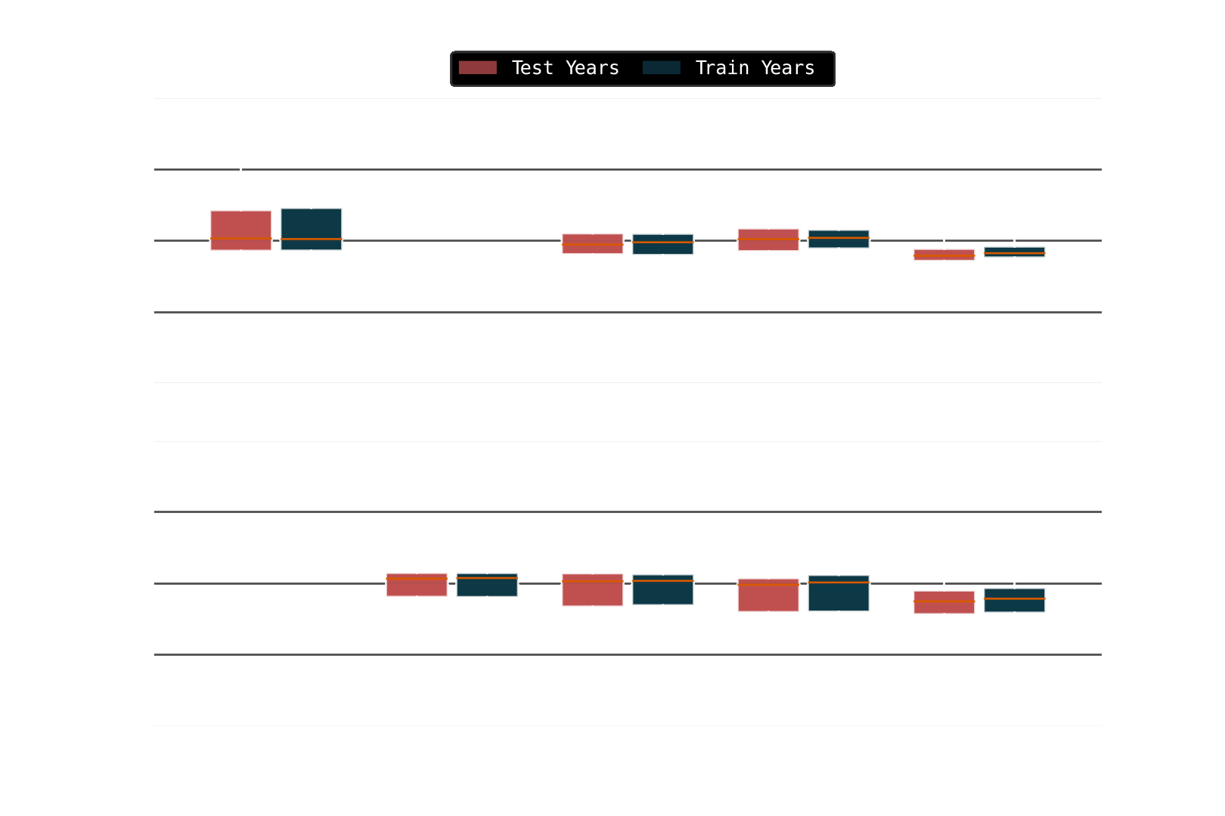
Regional relative deviation for ES/FR/DE System
Slightly lower differences when comparing simulations of weather years used to generate demand curves
Higher difference for PtH2 than PtH:
More similar prices compared to heat
Notes:
S37
- These plots illustrate the deviation in power-to-heat and hydrogen demands between the explicit modelling and the aggregated approach
- It illustrates that the differences can be up to +-50% across the three regions in any of the weather years.
- The differences are slightly lower when comparing the exact years that demand curves were generated from (blue boxes compared to red), indicating that you may not have to run all weather years in the sectorally explicit model.
- My expectation that increasing sectoral complexity - going towards the right-most scenarios on the x-axis here - seems to be proven false
- We see that the differences in power-to-hydrogen demands are higher than the differences for power-to-heat
- I explain this by the different flexibility characteristics assumed for each sector (which can be challenged):
- Hydrogen demand related to renewable fuel production can be satisfied at any point in time in BALMOREL, while heat demand must be delivered hourly according to an exogenous profile.
- Consequently, PtH2 production concentrates around periods of high VRE availability.
- This means fewer unique price levels in the demand curves, which limits the method’s ability to distinguish between different system states, thereby reducing accuracy compared to PtH

Slide 38
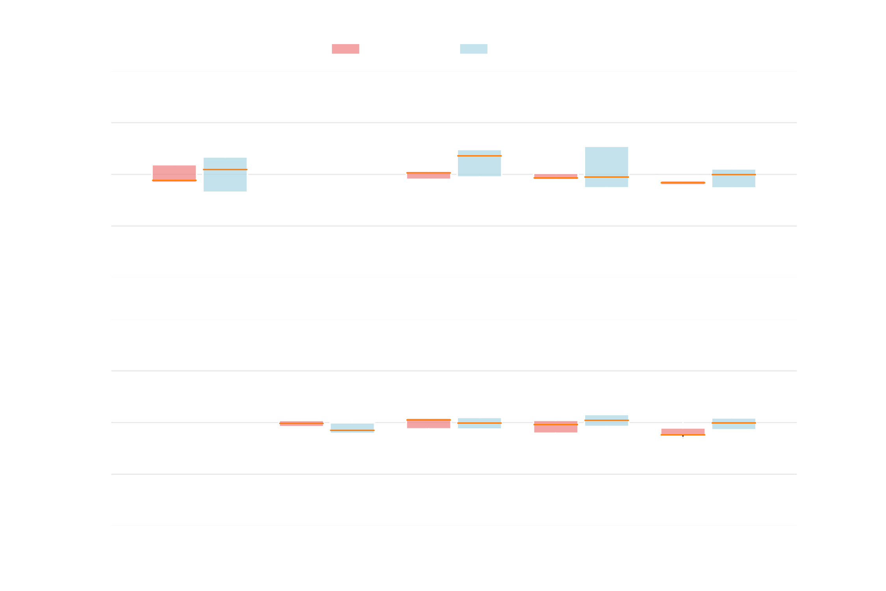

Regional relative deviation for European System - Weather Year 2000
Indicates that the method error does not scale with geographic scope for heat
Notes:
S38
- Moving on to the results in the large-scale, European case study:
- We compared the same difference here - large-scale system in blue, small-scale system in red
- This indicates that the error i was discussing for hydrogen before is amplified - however, the result for heat indicates that the error of the method does not necessarily scale with geographic scope.

Slide 39
Limitations
Method is currently limited to coupling between sectorally different models with the same temporal resolution
A constraint and fixed timeseries could be used instead, if an
endogenous response from the model you couple to is not required
Assuming BALMOREL is the ’truth’ in terms of sector coupled energy systems.
Differences in temporal foresight between the two models could have amplified differences
Notes:
S39
- The limitation of having to do a full simulation with the sectorally explicit model limits the use cases, maybe that simulation will be enough in most cases.
- Because of this limitation, a constraint and fixed timeseries of power-to-heat and -hydrogen demands might be a simpler way to do the coupling, if it's not necessary to endogenise demand.
- In this study, we assumed that the modelling of other sectors in BALMOREL is 'true' - that might of course not be the case, as many assumptions and aggregations are made in BALMOREL's representation of sectors
- Finally, the difference between the two models in term of temporal foresight could have amplified the error of the method - BALMOREL has full foresight within the year, ANTARES has myopic. Maybe it would have been a better choice to stick with one model in this case.

Slide 40
Research Question Answers
Sectors
How can electricity demands from heat and hydrogen sectors be represented in power system models?
Demand response can represent regional, annual PtH and PtH2 demands with a difference up to ±50%
  Higher accuracy on PtH
  Requires at least one weather year at hourly resolution
Future research can look into extrapolation methods, so a full, operational run of the sectorally explicit model is not necessary
Notes:
S40
- In conclusion...
- "How can ..."
- Representing the whole heat and hydrogen sector as a curtailable and shiftable demand response works up to 50% accuracy, compared to explicit modelling of those sectors.
- Expected PtH to be more inaccurately captured than PtH2 because of the more detailed modelling in BALMOREL compared to PtH2 - it was the opposite, exactly because of less details (less detailed supply curves - gets aggregated in implementation)
- It requires a simulation in the sectorally explicit model of one full year
- ..so future research could look into constructing these demand directly from the aggregated investment optimisation run, to make the use cases more broad
- This could help coupling sectorally different models, if it's infeasible to do explicit modelling, for example if the focus is on including more details in the model of lower sectoral resolution.

Slide 41
RQIII: How can energy carriers be aggregated and represented geographically in energy system models?
Notes:
S41
- Finally, we have research question III, on how carriers should be represented geographically in energy system models

Slide 42
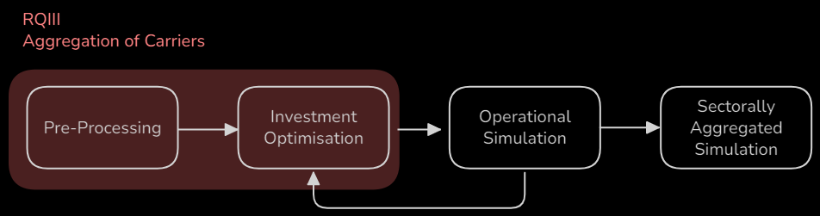
Motivation and Expectations
Develop precise model reduction techniques
Hypothesis: A hierarchical definition of energy carriers in the energy system model could be an efficient way to aggregate, and may eliminate the need for a soft-linking methodology
Notes:
S42
- This focuses on the pre-processing part of the toolchain, and in this case there was already some studies looking into soft-linking techniques that decompose the problems spatially
- Hence, the more important research gap to support modellers dealing with the source of complexity from space is in this case an analyses of *how* carriers are defined.
- Our hypothesis was that a hierarchical definition, with different resolutions per carrier, could be an efficient way to aggregate

Slide 43
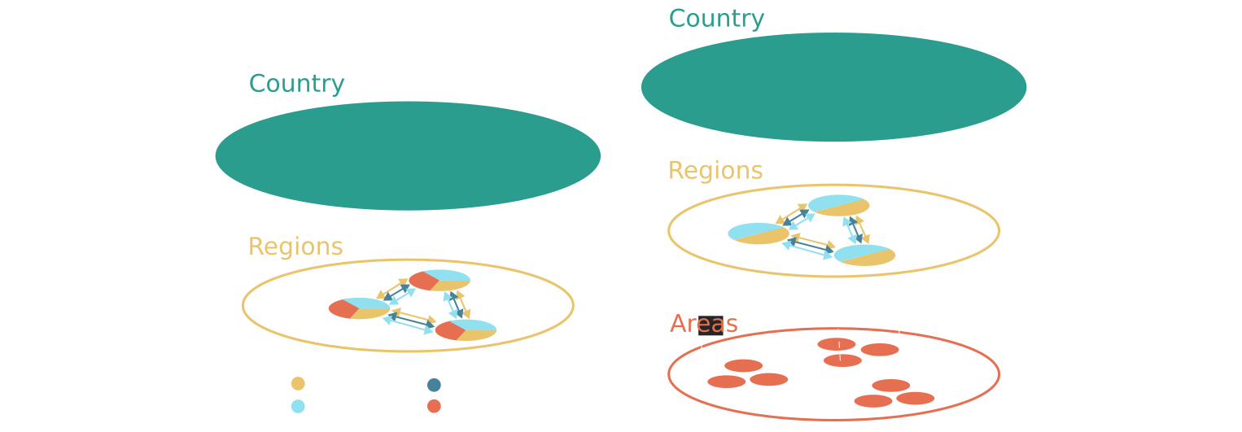
Tested Variants
Uniform Representation
Hierarchic Representation
Notes:
S43
- The variants that were compared in this case was the following:
- In both cases, demand for renewable fuels, policy constraints and financial conditions
- Then in the uniform representation, demand, transport, and investment options for all carriers are at the same regional level
- In the hierarchical representation, demand for heat and investment options for variable renewable energy is put in a higher resolved level, as studies that have previously included these resources and demands at a highly granulated level found the increased resolution to have an impact.

Slide 44
RQIII: Main Findings
Notes:
S44
- So, to the main findings...

Slide 45
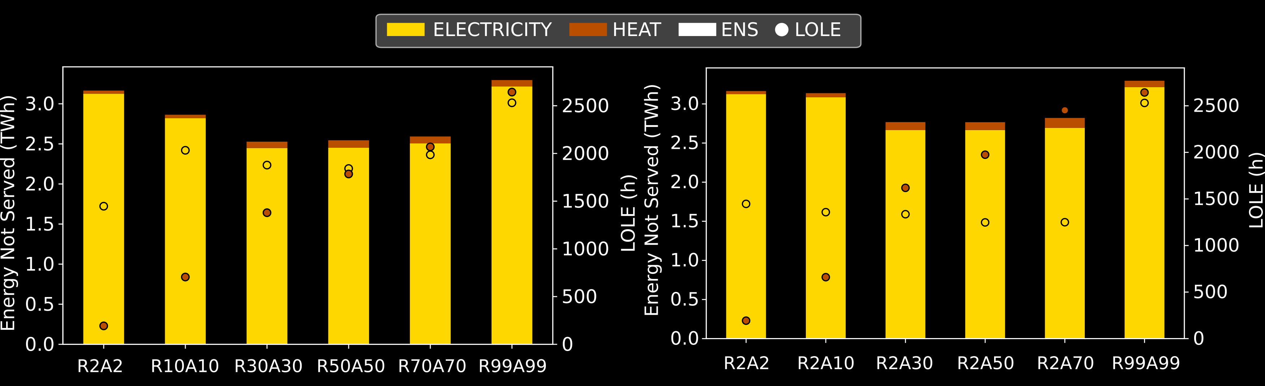
Adequacy Indicators are Underestimated
Higher Resolution 
Higher Resolution 
Uniform Representation
Hierarchic Representation
Notes:
S45
- These are adequacy indicators resulting from the simulation of the whole year for capacities resulting from optimising various resolutions for unifom and hierarchic representations
- Energy not served on the left axes depicted with bars, LOLE on the right depicted with circles
- We see that adequacy indicators are underestimated at coarser resolutions, if we assume that the highest resolution is the 'correct' one.
- The indicators for hydrogen and renewable fuel were zero
- This result also illustrates that a hierarchical representation can reproduce the heat adequacy indicators, as you can see on the right side of the figure.
- So if focusing on the adequacy of one carrier, it could be an efficient aggregation strategy

Slide 46
Limitations
More differences could appear if applying soft-linking strategy to find adequate configurations at highest spatial resolution
Limited scope: Denmark with less weather variation than larger regions
Uniform assumptions on transport costs: more geograhic details could show larger discrepancies at higher resolutions
Notes:
S46
- The adequacy indicators were quite high in the high spatial resolution case, which means that if we applied the bi-directional strategy from RQI it might exacerbate the differences because loss of load is quite high. On the other hand, energy not supplied is relatively low, and the capacities in the low spatial resolution scenario also increase when running it for all hours.
- Another limitation of this study is coming back to the issue with data availability - other studies found higher discrepancies because they studied a region where weather conditions change more than my relatively small case study
- Finally, uniform transport costs were applied, more geograhic details on this could also show larger discrepancies.

Slide 47
Research Question Answers
Space
How can energy carriers be aggregated and represented geographically in energy system models?
A hierarchical configuration can ‘reveal’ adequacy indicators with higher resolution for the carrier you are focusing on
Uniform, high resolution required for analysing adequacy indicators for all carriers
Overall results (capacities and costs) remained similar compared to other uncertainties
Future research could apply a bi-directional approach to find adequate configurations at high spatio-temporal resolution
Notes:
S47
- So, to conclude...
- A hierarchical configuration can ‘reveal’ adequacy indicators for the carrier you are focusing on
- Uniform, high resolution required for analysing adequacy indicators for both electricity and hydrogen
- Overall results (capacities and costs) remained similar compared to other uncertainties
- Future research could apply a bi-directional approach to find adequate configurations at high spatio-temporal resolution - this idea is based on one of the limitations...

Slide 48
Synthesis
Notes:
S48
- So, to sum all of this up...

Slide 49
Contributions to the ESM Toolchain
Hierarchical representation for efficient focus on a specific carrier, uniform if all are important
Demand response approach for endogenous representation in coupling sectorally different models
Use fictive demand or
capacity credit approach
Notes:
S49
- These contributions combine to support modellers in developing large-scale energy system models in the tool chain from pre-processing to operational runs, and between sectorally different simulations
1. A hierarchical spatial representation can be used to focus on a specific carrier
2. The fictive demand or capacity credit approach can be used in a bi-directional link to explore adequate and cost-optimal configurations
3. Demand response could be used as a rough, endogenous representation for other sectors when coupling sectorally different models

Slide 50
General Applicability
 Soft-linking techniques should provide similar results for other frameworks if model formulation and data input are similar.
 Sectoral soft-linking tested across various scenarios, strengthening wide
applicability compared to bi-directional strategies
~ Framework for DK spatial resolution configurations:
Modularly developed code, could be adapted to the input format of other
models
~ Soft-linking framework could be adapted to coupling other frameworks, but
wasn’t developed as modularly
Notes:
S50
- The general applicability of these recommendations should be discussed...
1. I don't expect the soft-linking techniques to change behaviour if applied in different frameworks with the same input data and model formulation. Of course, that is not often the case entirely, so the methods needs to be tested in practice for the specific case.
2. This logic is also why I am more confident that the sectoral soft-linking technique has a wide applicability, because it was tested across several scenarios and case studies.
- With regards to the general applicability of software developed...
- Framework for DK spatial resolution configurations:
Modularly developed code, could be adapted to the input format of other frameworks with some work
- Soft-linking processing code could be adapted to linking other frameworks, but was developed less modularly, so would require some more work to generalise - I got more aware of the benefit of modular code for wider applicability in the end of my PhD unfortunately

Slide 51

Implications
Soft-linking can be seen as a tool in the modeller’s toolbox, among model reduction techniques and other
Do spatial aggregation first, then temporal aggregation
Comparing the various case studies of the thesis provide insights on precision (’optimal’ solutions) vs. accuracy (systematic bias):
Notes:
S51
- I think my work shows that soft-linking should be seen as a tool in the modeller's toolbox among model reduction techniques, as I illustrated that it can make intractable problems tractable.
- It also implies that you should do spatial aggregation first, and then temporal aggregation, when trying to build a tractable model, as my thesis contains many example of the effect of temporal resolution and spatial
- Finally, if we compare the various case studies of the thesis, the point i mentioned in the introduction about precision and accuracy, and how using a variety of models or scenarios can increase accuracy and help shed light on the bigger picture:
1. Starting from research question one, where the case study was an interconnected, European, electricity and hydrogen system.
2. Using bi-directional methods to find adequate configurations by model year 2050 resulted in a 13-17% increase in power generation capacity.
3. This increase pales compared to when you include the heating system in the analysis, which is a scenario comparison you research question II made possible: a 62% increase in generation capacity.
4. If we then compare the results from the Danish system in research question II to the isolated case in research question III, we find a large increase in storage capacities flexibility that an interconnected system provides.
5. Finally, a small increase in hydrogen storage capacity when increasing spatial resolution.
- My take away from this comparison is that accounting for other sectors is the most important when analysing the configuration of the future energy system, and it makes me curious to explore what could happen if we - on top of this case study (interconnected, sector coupled European system) - account for insights from other fields.
- What else are we missing currently?

Slide 52

Future Research
Comparison of case studies throughout thesis illustrate that scope is important: Increase co-operation across fields
Notes:
S52
- This question is what makes me think that co-operation across fields is the most interesting and most important task for future research
1. And of course, my first intuition based on the work in the PhD project would be to attempt to do more soft-linking between these fields.
- But that would be the maximal effort, a minimal effort could just be discussion of results which is also being carried out to some extent
- You could ask if I'm not suggesting to develop an integrated assessment model, but I think my key point here is to preserve the 'worldview' that each model contributes with rather than striving to make one unified and probably intractable model
- It could be a way to provide more nuanced and robust decision support, in turn catalysing the green transition

Slide 53
References
¹ Scholz, Yvonne, Benjamin Fuchs, Frieder Borggrefe, and Karl-Kiên Cao. “Speeding up Energy System Models - a Best Practice Guide,” June 30, 2020.
² Chang, Miguel, Henrik Lund, Jakob Zinck Thellufsen, and Poul Alberg Østergaard. ‘Perspectives on Purpose-Driven Coupling of Energy System Models’. Energy 265 (February 2023): 126335. https://doi.org/10.1016/j.energy.2022.126335.
³ Hoffmann, Maximilian, Leander Kotzur, Detlef Stolten, and Martin Robinius. ‘A Review on Time Series Aggregation Methods for Energy System Models’. Energies 13, no. 3 (January 2020): 641. https://doi.org/10.3390/en13030641.
⁴ Heggarty, Thomas. ‘Techno-Economic Optimisation of the Mix of Power System Flexibility Solutions’. Université Paris, 2021.
⁵ Alimou, Yacine, Nadia Maïzi, Jean-Yves Bourmaud, and Marion Li. ‘Assessing the Security of Electricity Supply through Multi-Scale Modeling: The TIMES-ANTARES Linking Approach’. Applied Energy, ahead of print, 2020. https://doi.org/10.1016/j.apenergy.2020.115717.
⁶ Neumann, Fabian, Elisabeth Zeyen, Marta Victoria, and Tom Brown. ‘The Potential Role of a Hydrogen Network in Europe’. Joule, ahead of print, 12 July 2023. https://doi.org/10.1016/j.joule.2023.06.016.
⁷ Kountouris, Ioannis, Rasmus Bramstoft, Theis Madsen, Juan Gea-Bermúdez, Marie Münster, and Dogan Keles. ‘A Unified European Hydrogen Infrastructure Planning to Support the Rapid Scale-up of Hydrogen Production’. Nature Communications 15, no. 1 (2024): 5517. https://doi.org/10.1038/s41467-024-49867-w.
⁸ Raillard-Cazanove, Quentin, Antoine Rogeau, and Robin Girard. ‘Decarbonisation Modelling for Key Industrial Sectors Focusing on Process Changes in a Cost-Optimised Pathway’. Applied Energy 382 (March 2025): 125206. https://doi.org/10.1016/j.apenergy.2024.125206.
⁹ Kirkerud, J. G., N. O. Nagel, and T. F. Bolkesjø. ‘The Role of Demand Response in the Future Renewable Northern European Energy System’. Energy 235 (November 2021): 121336. https://doi.org/10.1016/j.energy.2021.121336.
¹⁰ Frysztacki, Martha Maria. ‘The Role of Spatial Scale in Electricity System Optimisation Models’. 2023.
¹¹ Vrain, Maxime, Virginie Dussartre, Nicolas Lhuillier, and Robin Girard. ‘A Spatially-Explicit Method for Generating Prospective District Heating Scenarios’. Energy 313 (December 2024): 133902. https://doi.org/10.1016/j.energy.2024.133902.
¹² Bogdanov, Dmitrii, Ayobami Solomon Oyewo, and Christian Breyer. ‘Hierarchical Approach to Energy System Modelling: Complexity Reduction with Minor Changes in Results’. Energy 273 (June 2023): 127213. https://doi.org/10.1016/j.energy.2023.127213.
¹³ Richardson, Katherine, Will Steffen, Wolfgang Lucht, Jørgen Bendtsen, Sarah E. Cornell, Jonathan F. Donges, Markus Drüke, et al. ‘Earth beyond Six of Nine Planetary Boundaries’. Science Advances 9, no. 37 (13 September 2023): eadh2458. https://doi.org/10.1126/sciadv.adh2458
¹⁴ Ekaterina Alekseeva. ‘Bilevel Approach to Optimize Electricity Prices’. ResearchGate, 22 October 2024. https://doi.org/10.2298/YJOR171115002A.
¹⁵ Collins, Seán, John Paul Deane, Kris Poncelet, et al. ‘Integrating Short Term Variations of the Power System into Integrated Energy System Models: A Methodological Review’. Renewable and Sustainable Energy Reviews 76 (September 2017): 839–56. https://doi.org/10.1016/j.rser.2017.03.090.
¹⁶ Balanza, Théo, Nicolas Campion, Mathias Berg Rosendal, Rasmus Bramstoft, and Anders Bjørn. ‘Exploring Configurations of a European Energy System within the Planetary Boundaries’. Environmental Research Letters 20, no. 7 (2025): 074050. https://doi.org/10.1088/1748-9326/ade26b

Slide 54
References
¹⁷ Kotzur, Leander, Lars Nolting, Maximilian Hoffmann, et al. ‘A Modeler’s Guide to Handle Complexity in Energy Systems Optimization’. Advances in Applied Energy 4 (November 2021): 100063. https://doi.org/10.1016/j.adapen.2021.100063.
¹⁸ Thompson, Erica L., and Leonard A. Smith. ‘Escape from Model-Land’. Economics 13, no. 1 (2019): 20190040. https://doi.org/10.5018/economics-ejournal.ja.2019-40.
¹⁹ Holger Teichgraeber, Lucas Elias Küpper, and Adam R. Brandt. ‘Designing Reliable Future Energy Systems by Iteratively Including Extreme Periods in Time-Series Aggregation’. In: Applied Energy 304 (Dec. 2021), p. 117696. issn: 0306-2619. doi: 10.1016/j.apenergy.2021.117696. (Visited on 11/06/2025).
²⁰ Matija Pavicevic, Paolo Thiran, Gauthier Limpens, Francesco Contino, Hervé Jeanmart, and Sylvain Quoilin. ‘Bi-Directional Soft-Linking between a Whole Energy System Model and a Power Systems Model’. In: IEEE PES/IAS PowerAfrica. 2022. doi: 10.1109/PowerAfrica53997.2022.9905392.
²¹ Juan Carlos Osorio-Aravena, Arman Aghahosseini, Dmitrii Bogdanov, Upeksha Caldera, Narges Ghorbani, Theophilus Nii Odai Mensah, Jannik Haas, Emilio Muñoz-Cerón, and Christian Breyer. ‘Synergies of Electrical and Sectoral Integration: Analysing Geographical Multi-Node Scenarios with Sector Coupling Variations for a Transition towards a Fully Renewables-Based Energy System’. In: Energy 279 (Sept. 2023), p. 128038. issn: 0360-5442. doi: 10 . 1016 / j . energy . 2023 . 128038. (Visited on 03/13/2025).

Slide 55
Research Gap
A lot of work on spatial aggregation for power system models¹⁰, some on technological aggregation for district heating¹¹
One study proposed a sequential soft-linking method¹²
Gap in studies investigating spatial representation of carriers in sector-coupled systems
Space
Måske et slide per dimension, inkludér
Weather
A lot of work on temporal aggregation within a weather year³
Few bi-directional methods for optimal capacities throughout weather years⁴ ⁵
No study comparing bi-directional soft-linking methods
Trend has been to explicit modelling or linking of sectorally different models⁶ ⁷ ⁸
Demand response has been used to represent other sectors, but not compared to explicit modelling⁹
Sectors

Slide 56
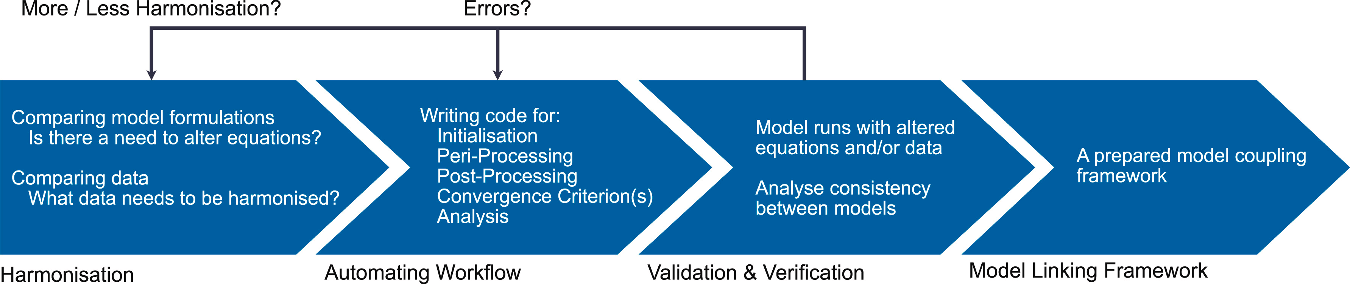
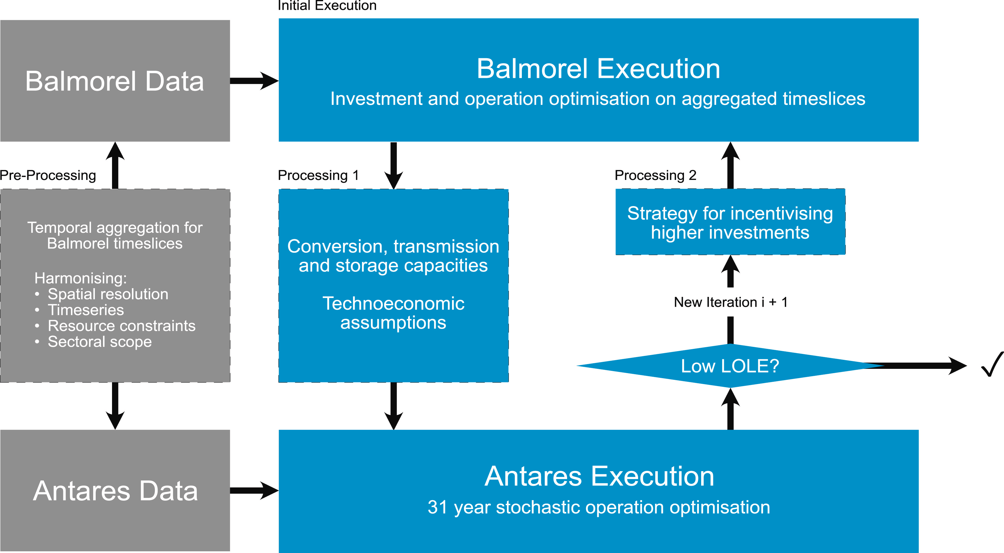
The Process of Coupling
”Peri-Processing” was just my word for processing in-between

Slide 57
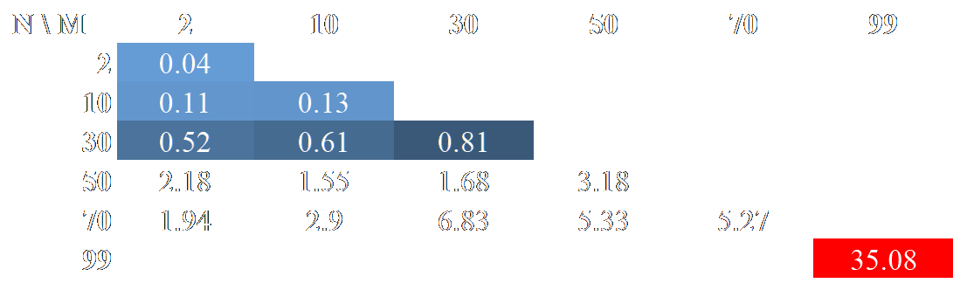
Computation Time for Investment Runs
Heat and investment option nodes
Electricity, hydrogen and synfuel nodes
CPU time in hours

Slide 58
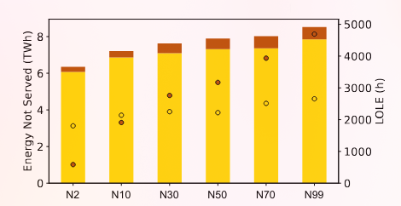
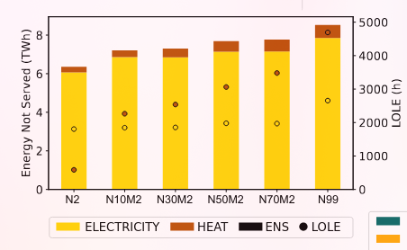
Adequacy Related Results
Carriers modelled at same level
Operational runs after investment runs at similar temporal resolution
Heat balance modelled in several areas within el. and H2 copperplates
Higher resolution in heating compared to electricity and hydrogen can ’reveal’ adequacy indicators with much lower CPU costs
Increasing resolution

Slide 59
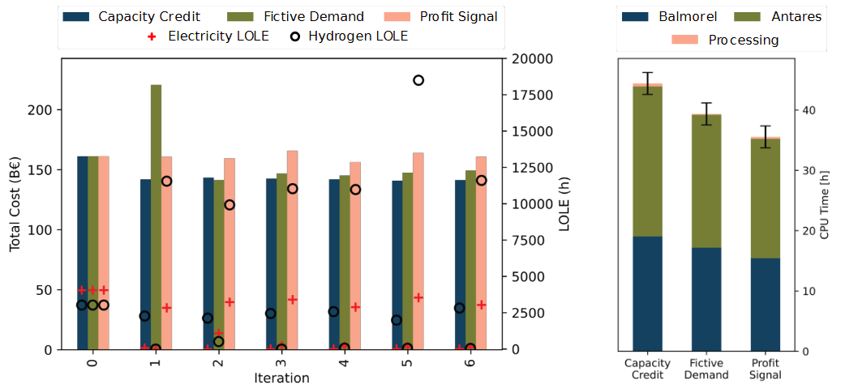
Results
System not adequate in the first iteration

Slide 60
Results
Fictive demand approach succesfully decrease both electric and hydrogen LOLE

Slide 61
Results
Capacity credit reduces electricity LOLE, but not hydrogen

Slide 62
Results
Profit signal fluctuates

Slide 63
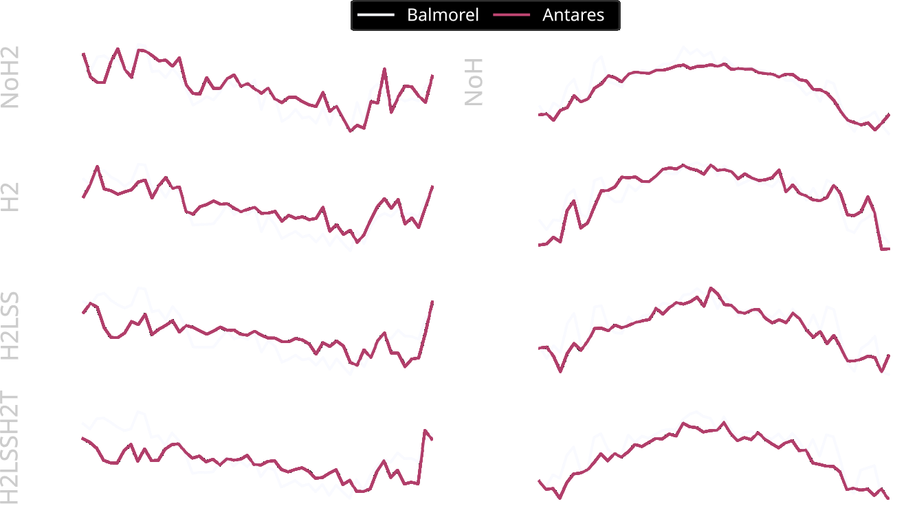
Results – Seasonal matching at large scale

Slide 64

Results – Difference between weather years for Balmorel
Balmorel inter-weather year difference is lower than method error

Slide 65

The Pan-European, Sector-Coupled, Multi-Weather Year Investment Optimisation Problem
A recipe:
Iteratively find adequate and low-emission capacities
Couple to high-resolution model, if high accuracy on adequacy is necessary
Use demand response model to account for other sectors if not focussing on those

Slide 66
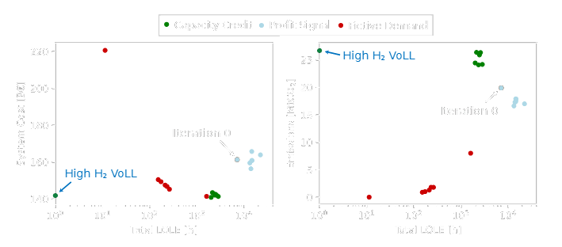
Pareto Fronts
Overall:
Profit signal can’t stand alone for this type of problem
Capacity credit can reduce costs but increase emissions
Fictive demand reduce emissions but increase costs

Slide 67
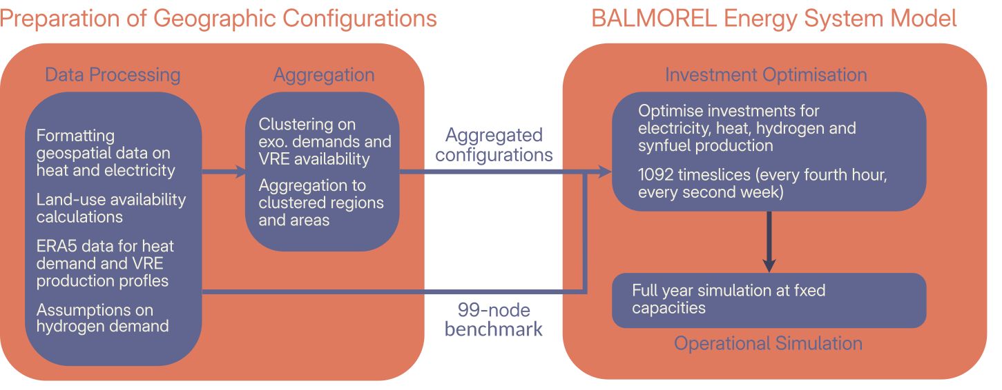
Framework

Slide 68


Heuristics and Decomposition Techniques
to solving complex problems, e.g. Frysztacki’s approach for ’checking’ feasibility by disaggregating a investment optimisation to operational runs at higher spatial resolution
In Reinert’s
?
There are still trade-offs to developing tractable ESMs that doesn’t lead to a systematic bias
towards one corner of the energy trilemma

Slide 69
Useful numbers, but where did they come from?
Large-scale energy system optimisation model (ESM)
min Z
s.t. Ax >= b
- Bottom-up, partial equilibrium
- Technoeconomic assumptions
-

Slide 70

Method variants
Constraints driven approach
Objective function driven approach
Parameter driven approach
Gong et al.: ’Price-driven approach’ can be a more ’endogenous’ linking strategy → less strict than constraint-driven approach (cite)

Slide 71
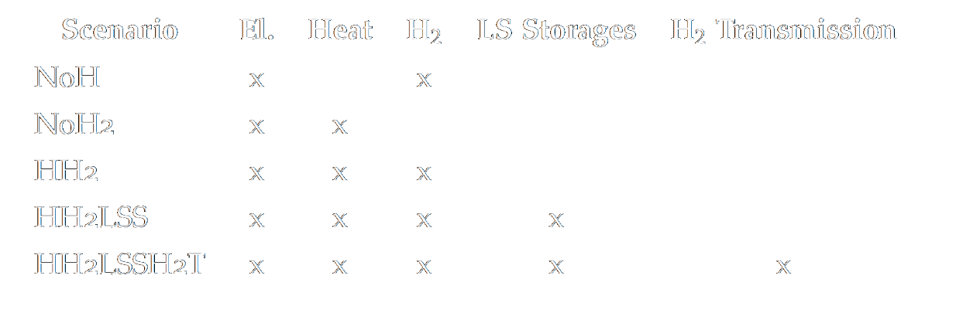
Methods - Scenarios
For a ES/FR/DE and a European system

Slide 72
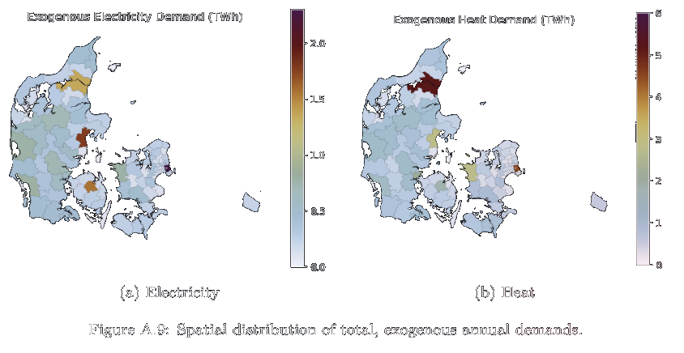
Case study
Spatially detailed databases on electricity and heating demands, including biomass potential estimates for Denmark
District heating is an important potential solution for other systems, and we therefore expect the data available in Denmark to give a more interesting prospective scenario with spatial effects
A prospective, high-electrification, net-zero 2050, islanded scenario is used

Slide 73
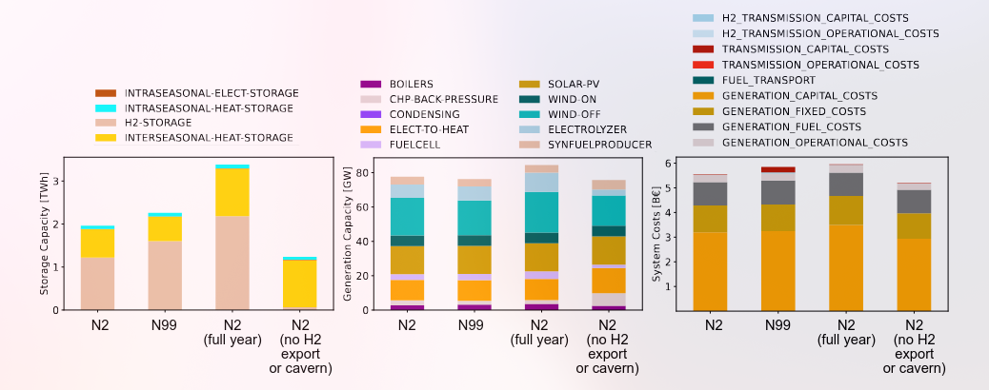
Other Uncertainties are More Important to Overall Results
Results on storage capacity, generation capacity and system costs
Difference between most spatially aggregated case and least is less than other uncertainties

Slide 74
Methods for Complexity Reduction
Heuristic decomposition, e.g. solving one week at a time¹
Temporal³-, spatial¹⁰- and technological¹¹ aggregation
Precision
Decompose mathematical formulation into master and subproblems¹⁷
Speed-up
Figure from Scholz et al.¹

